Slide 1
Types of Database Keys
Understanding the different keys used in relational databases

Slide 2
Super Key
Definition: Set of one or more attributes that can uniquely identify a tuple.
Can include extra attributes not necessary for uniqueness.
Example: STUD_NO, (STUD_NO, STUD_NAME)
Super key example: (STUD_NO, PHONE)

Slide 3
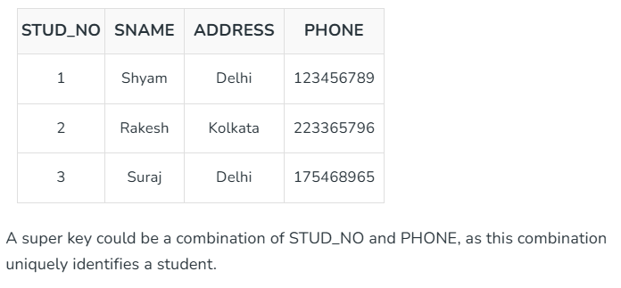
Super key

Slide 4
Candidate Key
Definition: Minimal set of attributes that can uniquely identify a tuple.
A minimal super key with no extra attributes.
Example: STUD_NO in STUDENT table
Composite key: {STUD_NO, COURSE_NO} in STUDENT_COURSE

Slide 5
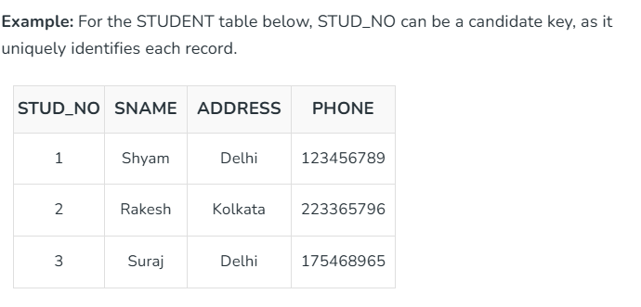
Candidate Key

Slide 6

Candidate Key

Slide 7
Primary Key
Chosen candidate key to uniquely identify records.
Must be unique and not NULL.
Can be single-column or composite.
Example: STUD_NO in STUDENT table

Slide 8
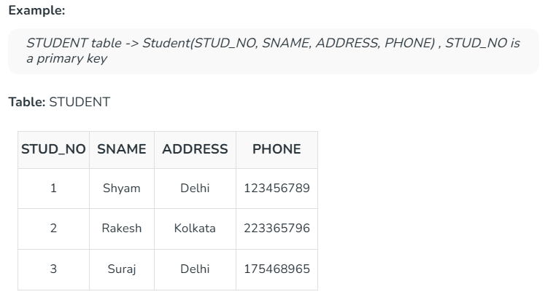
Primary Key

Slide 9
Alternate Key
Candidate key not chosen as the primary key.
Also called secondary key.
Example: If STUD_NO is primary, PHONE is alternate key

Slide 10
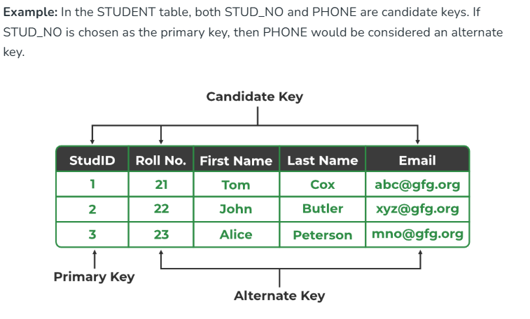
Alternate Key

Slide 11
Foreign Key
Attribute in one table that references primary key of another table.
Ensures data integrity and relationship between tables.
Example: STUD_NO in STUDENT_COURSE references STUDENT.STUD_NO

Slide 12
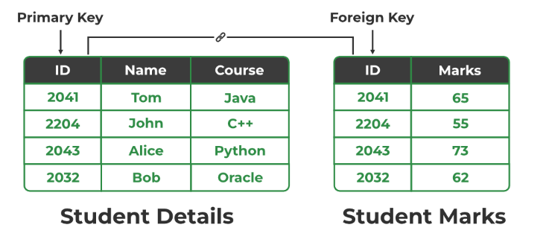
Foreign Key

Slide 13
Composite Key
Combination of two or more attributes to uniquely identify a row.
Can act as primary key if no other key exists.
Example: {STUD_NO, COURSE_NO} in STUDENT_COURSE table

Slide 14
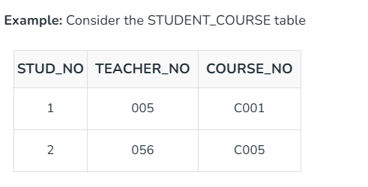
Composite Key

Slide 15
Summary Table of Keys
Super Key: (STUD_NO, PHONE)
Candidate Key: STUD_NO
Primary Key: STUD_NO
Alternate Key: PHONE
Foreign Key: STUD_NO in STUDENT_COURSE
Composite Key: {STUD_NO, COURSE_NO}

Slide 16
